Slide 1

Welcome
Welcome to Annie Lennard Nursery School and the Early Years Team!
We provide a safe, happy and caring environment that gives your child the perfect start in getting ready for starting school and the next stage of their learning.
As part of Annie Lennard Primary School we provide free high quality care and development for all children from aged 3 years. Our highly trained professional team respect each child as an individual and help them develop confidence, independence and self-esteem.
We would love you to come and see all the wonderful exciting things we are doing in our Nursery. Please get in touch.

Slide 2

Find out About us

Slide 3
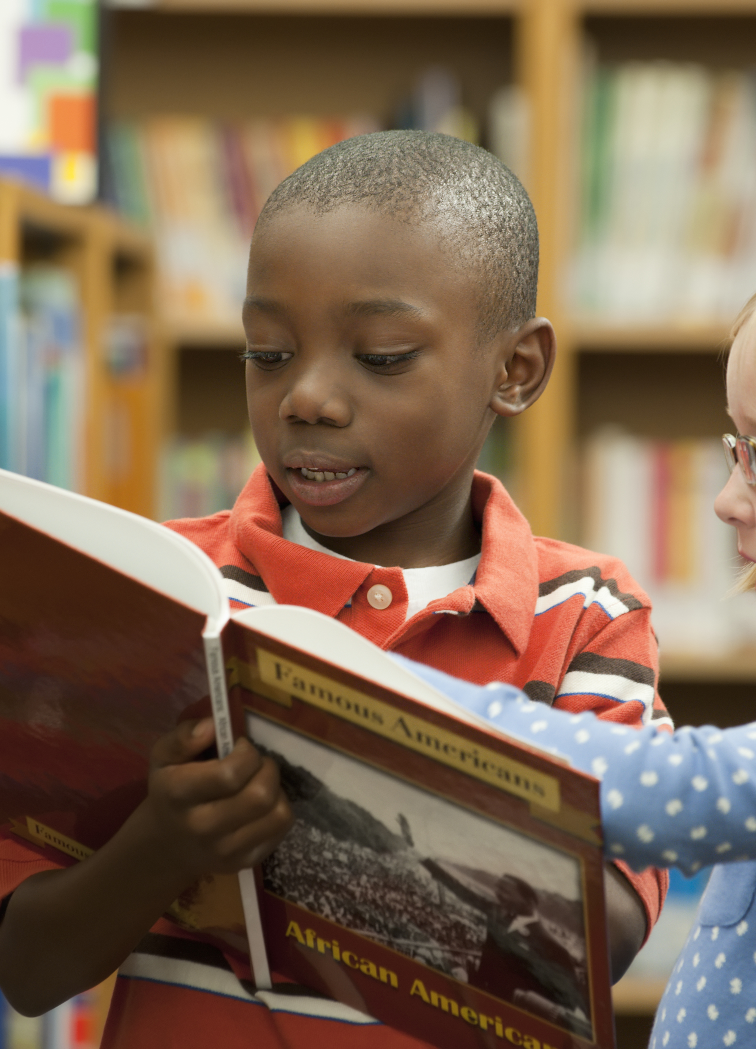
Teaching and learning
Learning is at the heart of what we do. We aim to bring learning alive and provide rich, memorable and engaging experiences.
Our professional , qualified teaching staff utilise active teaching methods to focus on communication, language, maths and understanding the world, making learning fun and exciting.
We closely follow the statutory framework for the early years foundation stage which sets the standards for learning, development and care of children.

Slide 4

Parents as partners
We work together with parents transparently and value opinions and suggestions from all. We have an open door policy for parents, the school is a support network for parents and children, we believe the more we can help families the more settled and successful your child will be. We make full use of specialist IT software to safely and securely build a special record of your child's experiences, development and learning journey throughout their time in Nursery, this enables you to view your childs progress, interact and communicate with your child's teachers.

Slide 5

Nurturing
We aim to cater for all children's needs and recognize that children learn best in different ways. We have strong SEND and Family Support specialists in school to provide support. We value the strengths of each child and develop them, providing support and encouragement along the way. We believe in fun, laughter and happiness and want all of our children to enjoy their learning. Our priority is to nurture and give our children opportunities to be successful and develop into caring, happy and thoughtful young people.

Slide 6
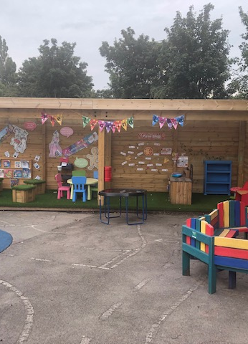
Facilities
Our school is safe and secure, we are fortunate enough to have well equipped classrooms as well as our outdoor area which is specifically designed to stimulate active, imaginative and creative play as well as our outdoor classroom to enable outdoor learning every day.

Slide 7
Meet the team

Slide 8
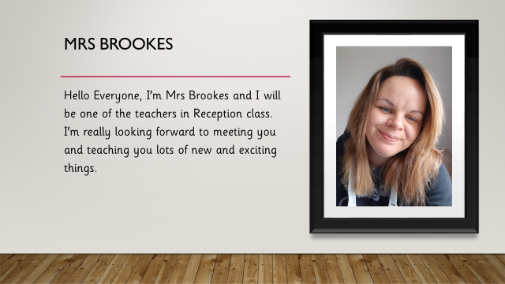
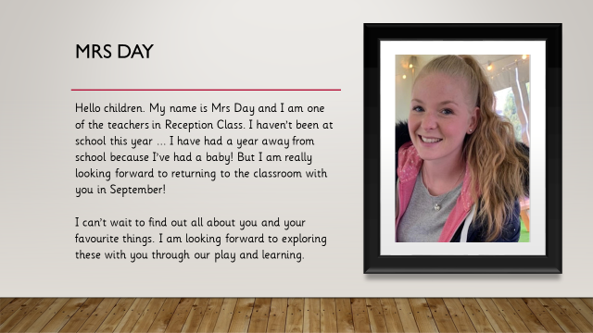
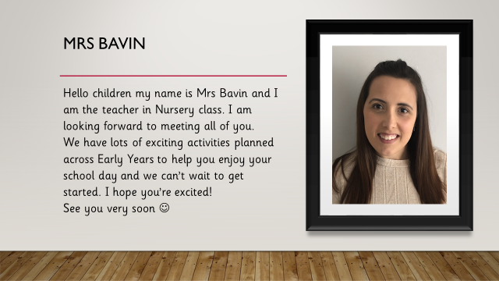
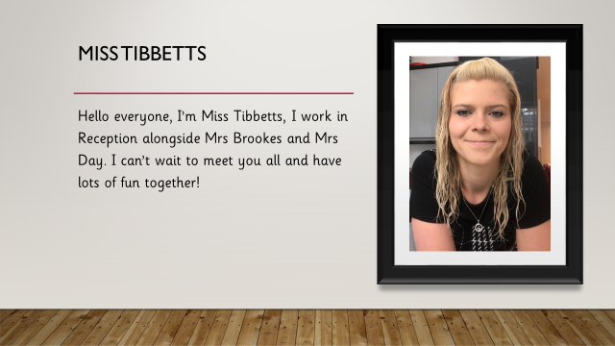
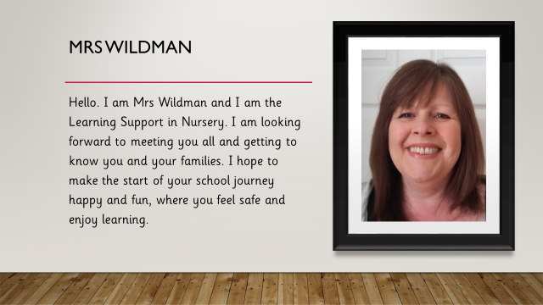

Slide 9
Get in touch
Call us
0121 429 4284
Email us
Kimberley.sirett@annielennard.sandwell.sch.uk
Denise.goldbytimmis@annielennard.sandwell.sch.uk
Find us
The Oval
Smethwick
B67 6LE

